Slide 1
DSDM Practise :
Facilitated Workshops
Modelling
Iterative Development

Slide 2
Outline
Other DSDM Practices :
  Facilitated Workshops
  Modelling
  Iterative Development

Slide 3

Facilitated Workshops
"A structured group meeting to enable participants to reach a predetermined objective in a compressed time frame, supported by a neutral facilitator.”
Success Factors
Effective, trained, independent Workshop Facilitator
Flexibility in format, within clearly defined objectives
Thorough preparation (by Facilitator and Participants)
Ability to build in outputs from previous workshops
Decisions and agreements not forced
Workshop report distributed to participants soon afterwards

Slide 4

Facilitated Workshops
"A structured group meeting to enable participants to reach a predetermined objective in a compressed time frame, supported by a neutral facilitator.”
Benefits
Rapid, high quality team decisions
Greater buy-in and ownership from all stakeholders
Clarification of issues and enhanced communication
Building team spirit and consensus

Slide 5
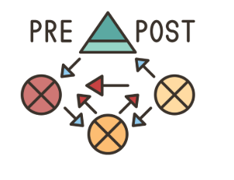
Key DSDM Practice: Modelling
Visual representation of problem or solution
Description or analogy to help visualise something that cannot be directly observed.
A small but exact copy of something
A pattern or figure of something to be made
Often used to describe a set of diagrams

Slide 6

Key DSDM Practice: Modelling
Purpose of Modelling
Improves communication and prompts the right questions.
Helps confirm expectations, test achievability of objectives, and validate requirements.
Makes solution elements visible early (e.g., diagrams, prototypes, mock-ups).
Should only be detailed enough to serve the purpose—avoid unnecessary effort.
Often involves abstraction: omitting details to focus on specific aspects.
Modelling Perspectives
Provides a coherent picture of a solution area.
Considers perspectives: What, How, Where, Who, When, Why.
Shows relationships between these perspectives.

Slide 7
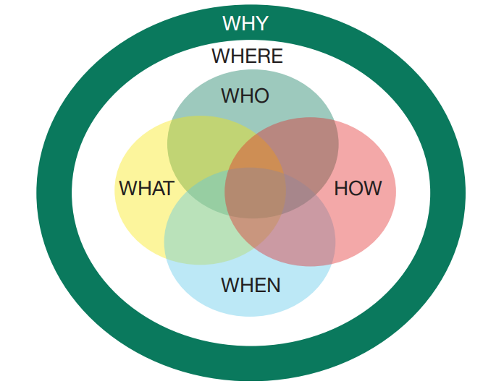
Key DSDM Practice: Modelling
Diagram: Modelling Perspectives
A Venn diagram shows the six perspectives:
WHAT – Information within the solution area (data, relationships, business rules).
HOW – Functions, features, and processes.
WHERE – Locations of business operations (in relation to the solution).
WHO – People (customers, users, stakeholders).
WHEN – Events important to the business (time, scheduling).
WHY – Business objectives and strategy.

Slide 8
Key DSDM Practice: Iterative Development
Solution evolves through cycles of iterative development
Each cycle moves solution from high-level concept closer to something with acknowledged business value
Each cycle should be:
- As short as possible
- Only as formal as necessary
Typically after an initial conversation, follow cycles of
Thought, Action and Conversation

Slide 9
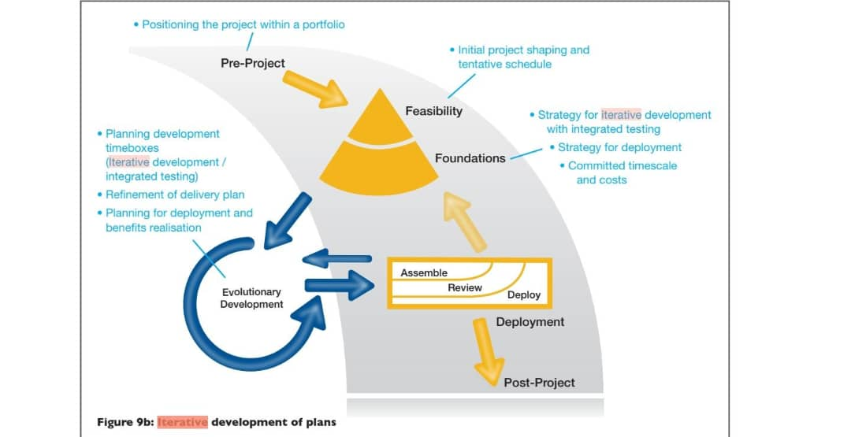
Key DSDM Practice: Iterative Development
Planning Iterative Development
Strategy decided during Foundations phase
Large solution broken into small manageable chunks
Work delivered in Timeboxes (short, fixed periods)
Each Timebox contains prioritized requirements/user stories
Benefits:
  Easier progress tracking
  Faster delivery of usable increments
  Reduced project risks

Slide 10

Key DSDM Practice: Iterative Development
Controlling Iterative Development
Each cycle delivers incremental improvements
Reviews may show:
  Wrong evolution of solution
  Changing business needs
  New issues discovered
Configuration Management ensures correct versions and stability
Benefits:
  Maintains solution integrity
  Encourages flexibility and adaptability

Slide 11

Key DSDM Practice: Iterative Development
Quality in Iterative Development
Core rule: Never compromise quality
Quality defined early and verified continuously
Verification methods:
  Reviews (static): check documents, designs, code
  Testing (dynamic): run deliverables to confirm behavior
Benefits:
  Detects defects early
  Builds stakeholder confidence
  Ensures solution is fit for purpose

Slide 12

Key DSDM Practice: Iterative Development
Reviews & Testing
Reviews: from informal peer checks → structured formal reviews
Types of Tests:
  Positive – confirm expected behavior
  Negative – block invalid actions
  Unhappy Path – test unusual cases
Good tests include:
  Starting state
  Set of actions
  Expected outcome
Benefits:
  Improves reliability
  Reduces risk of failure

Slide 13
Key DSDM Practice: Iterative Development
Roles & Responsibilities
Technical Coordinator
  Ensures quality from technical perspective
  Validates non-functional requirements are met
  Oversees technical reviews and rigorous testing
Solution Tester
  Responsible for most testing activities
  Exceptions:
    Business acceptance testing → Business Ambassadors/Advisors
    Unit testing → Solution Developers
  Provides testing knowledge & expertise to the team

Slide 14

Key DSDM Practice: Iterative Development
Iterative Development & Incremental Delivery
Each Timebox should ideally deliver a potentially deployable increment
Testing integrated into development & delivery process
Benefits:
  Reduces project risks
  Supports early return on investment through incremental delivery

Slide 15
Key DSDM Practice: Iterative Development
Investigate, Refine, Consolidate (IRC)
Used for each requirement/user story/product
Investigate – understand details, define acceptance criteria
Refine – develop and enhance solution
Consolidate – converge on accurate solution
Helps avoid excessive iterations
Reviews scheduled within Timebox → maintain business focus & stakeholder engagement

Slide 16

Questions on other practises?

Slide 17
EXERCISES
What is Iterative Development?
a) A practice where features are designed, developed and tested
b) A gated process where development can not begin until the finished design is complete
c) An early sample, model or release of a product to test a concept or process
d) The process and activity of planning, organizing, motivating and controlling resources to
achieve a specific goal
In a free format Timebox, which activity is carried out during the Iterative Development step?
a) Agree what work will be undertaken, agree priorities and accept the workload
b) Scheduled reviews of the work in progress
c) Formal acceptance of the Timebox deliverables
d) Workshop to learn from experience and to take action to improve future Timeboxes

Slide 18
EXERCISES
3. During Iterative Development, which testing activity is the responsibility of the Solution Tester?
a) Business acceptance testing
b) Unit testing of a feature
c) Ensuring that testing is sufficiently comprehensive
d) Providing testing knowledge and expertise
4. When using Iterative Development, what should each cycle begin and end with?
a) Complete solution
b) Conversation
c) Facilitated Workshop
d) Timebox

Slide 19
EXERCISES
5. Identify the missing word(s) in the following sentence:
A DSDM project will always deliver a viable solution, as long as the practices of [?] and Timeboxing are followed.
a) Daily Stand-ups
b) MoSCoW
c) Iterative Development
d) Incremental Delivery

Slide 20







THANK YOU
In the Name of God for Mankind
www.utm.my

